Slide 1
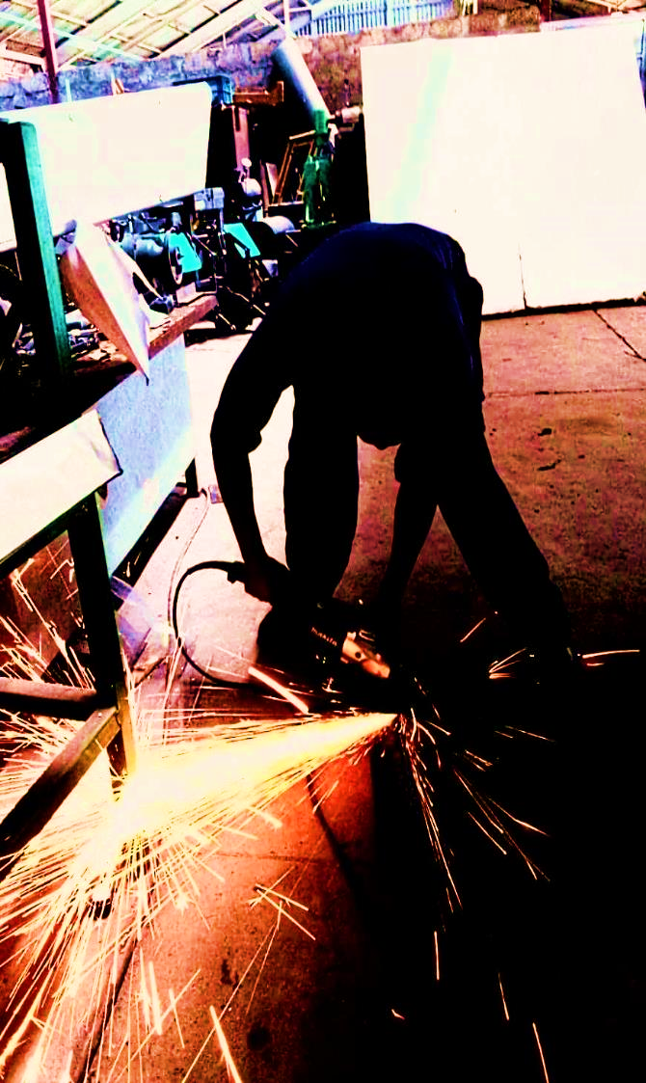
WEEK 4 SOLID TEAM REPORT
NAKUJA PROJECT

Slide 2
WEEKLY OBJECTIVES
COOKING
COOKING OF GRAINS
TEST STAND
CALCULATIONS AND WELDING
MOTOR HOLDER
MAKING A NEW ALUMINIUM MOTOR HOLDER
DISASSEMBLY AND ANALYSIS
MOTOR DISASSEMBLY AND STATIC TEST RESULTS ANALYSIS
IGNITION CIRCUIT
PREPARATION OF IGNITION CIRCUIT AND IGNITORS
NOZZLE
SIMULATION OF AIR FLOW IN THE NOZZLE

Slide 3
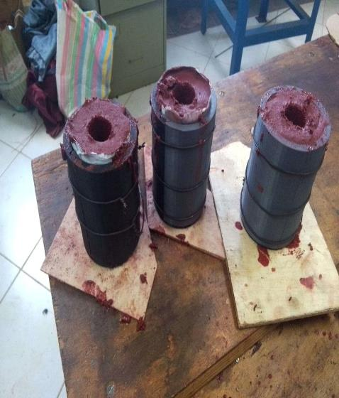
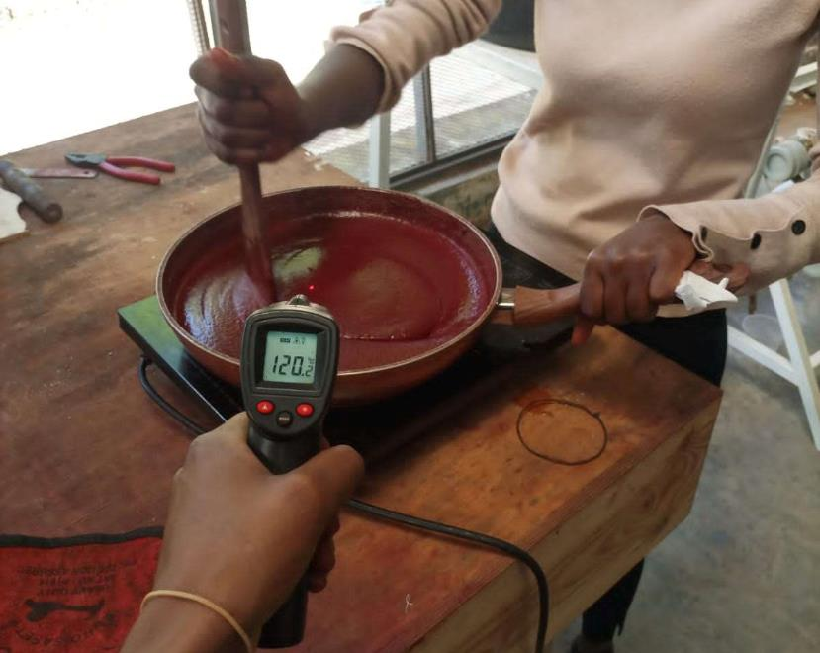
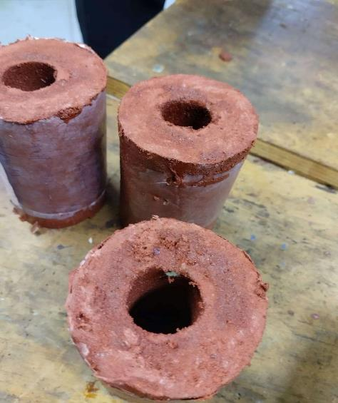
#40 COOKING OF THE GRAINS
Three grains were cooked and casted

Slide 4
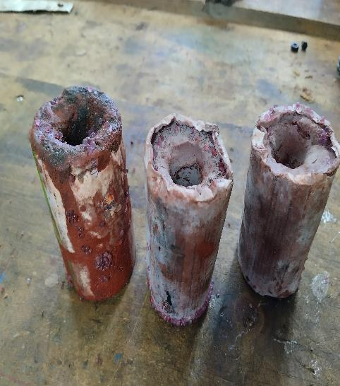
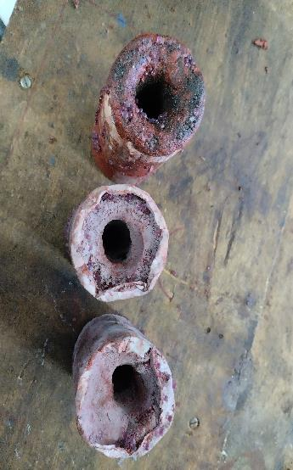
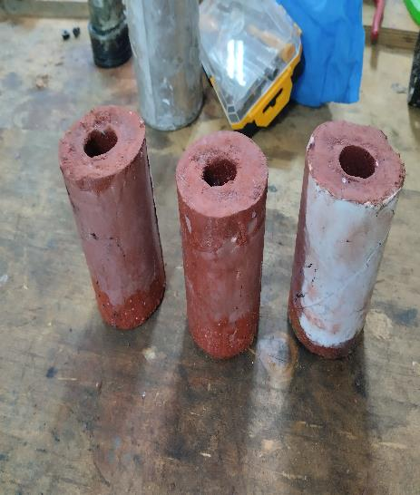
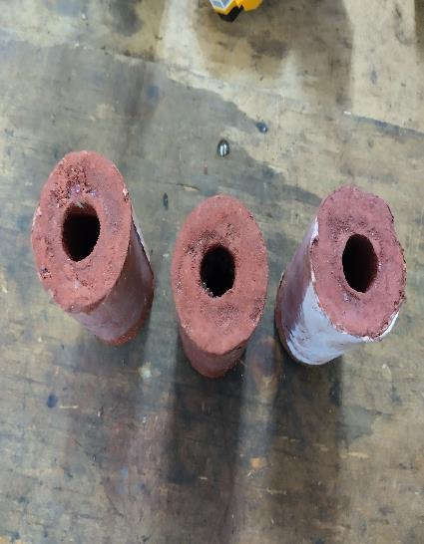
COOKING OF THE GRAINS
PREVIOUS GRAINS
CURRENT GRAINS

Slide 5
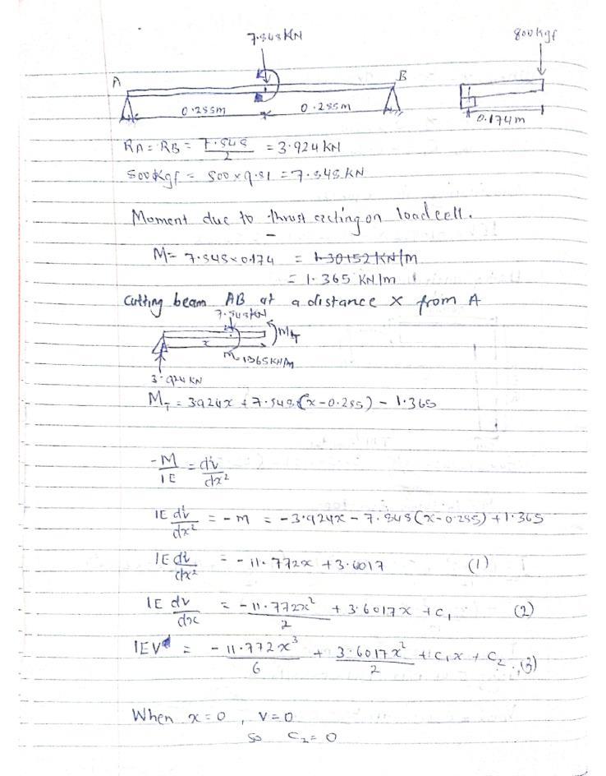
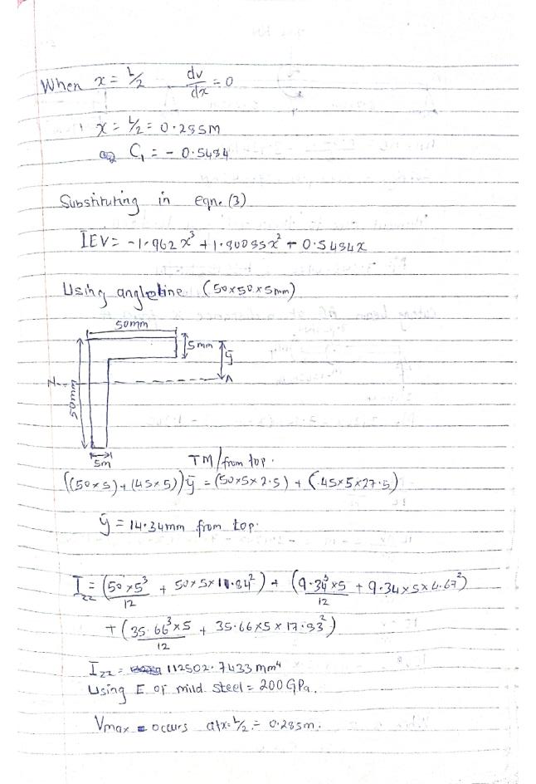
#55 TESTSTAND CALCULATION
CALCULATION OF THE ANGLELINE BAR SUPPORTING LOADCELL ON THE TESTSTAND

Slide 6
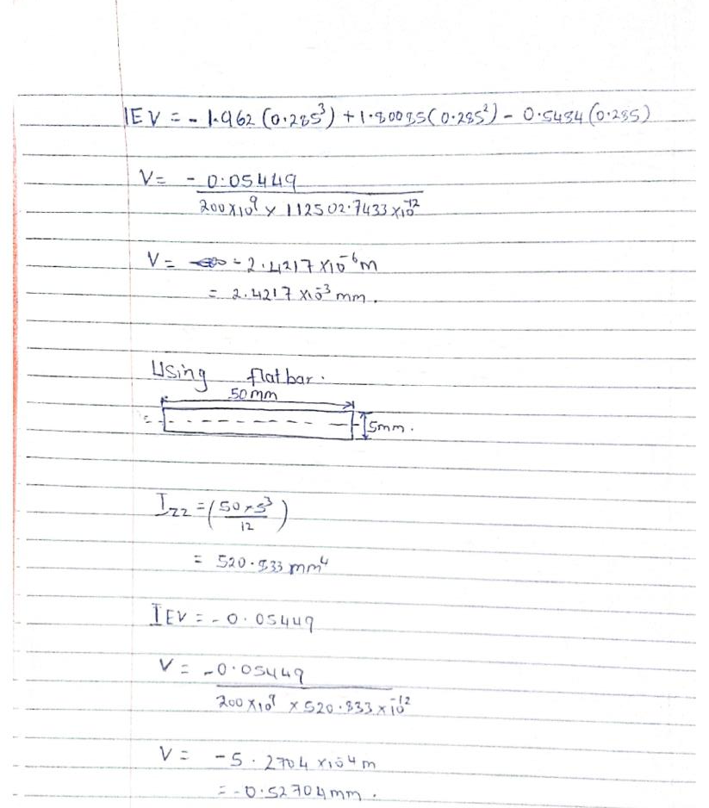
TESTSTAND CALCULATION
FROM THE CALCULATIONS:
L-Shaped bar can withstand more force and moment than the flat bar(minimum deflection on L-shaped)

Slide 7
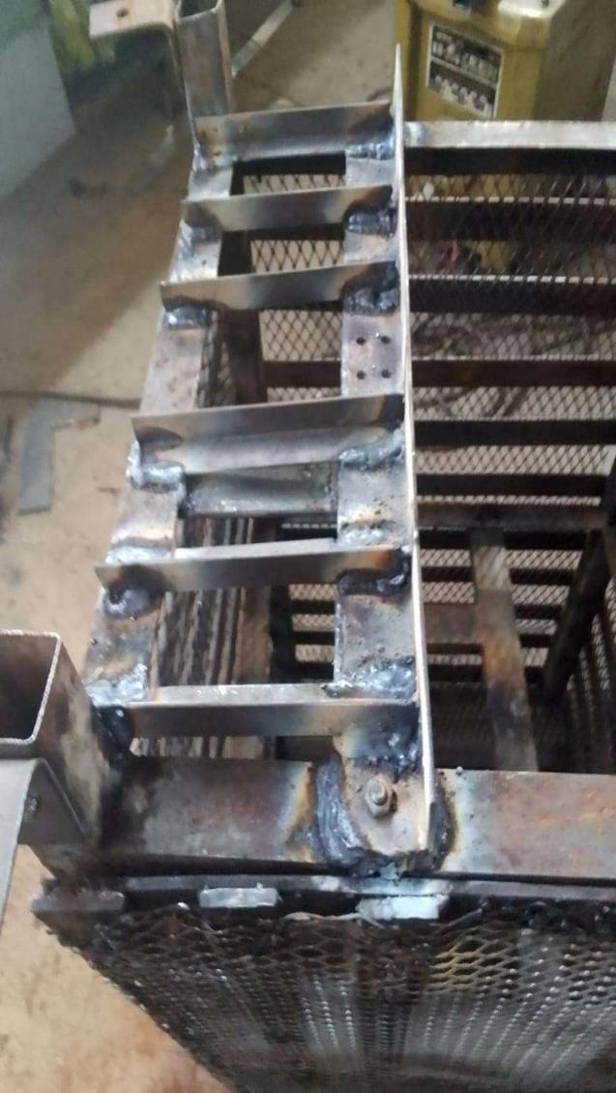
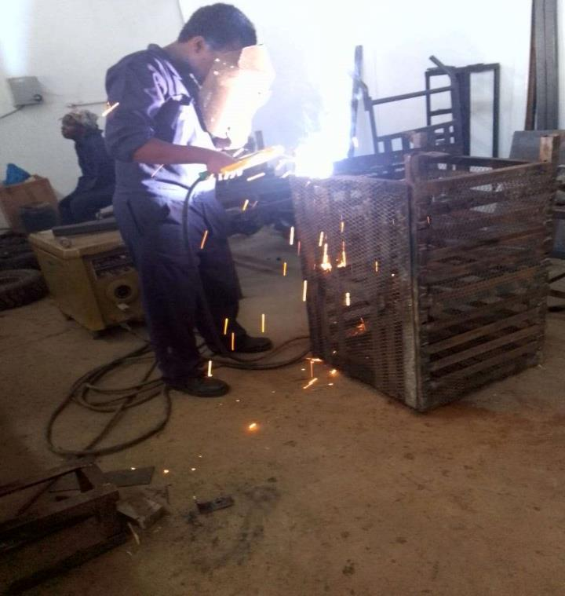
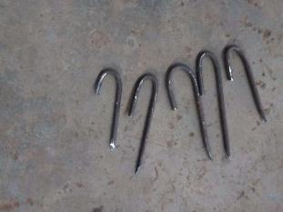
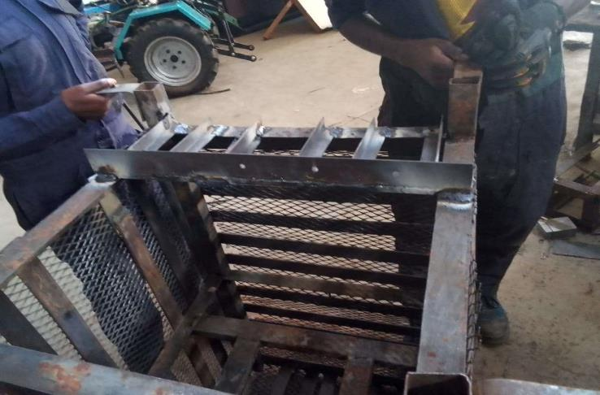
#56 REINFORCEMENT OF TESTSTAND
L-shaped bars used to reinforce the load cell support.

Slide 8
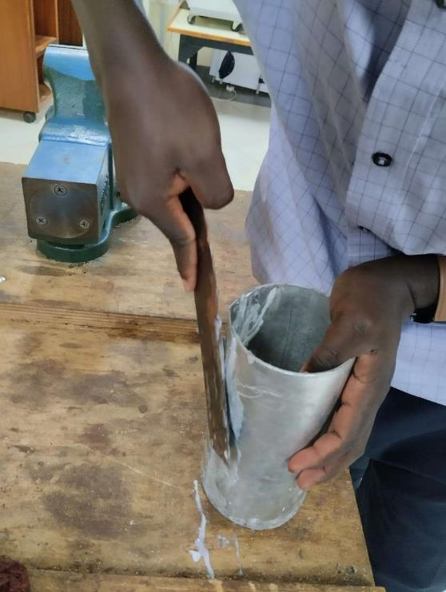
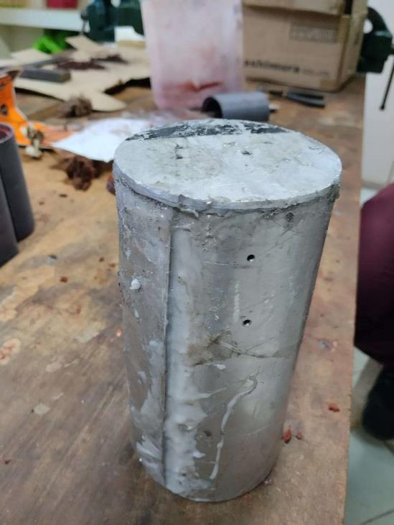
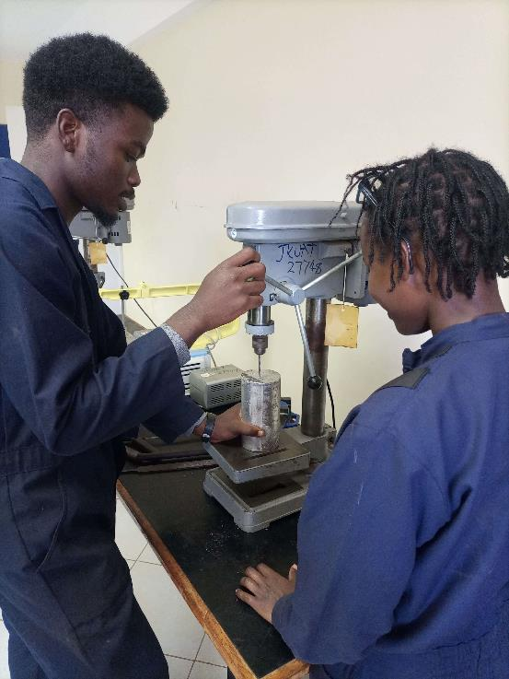
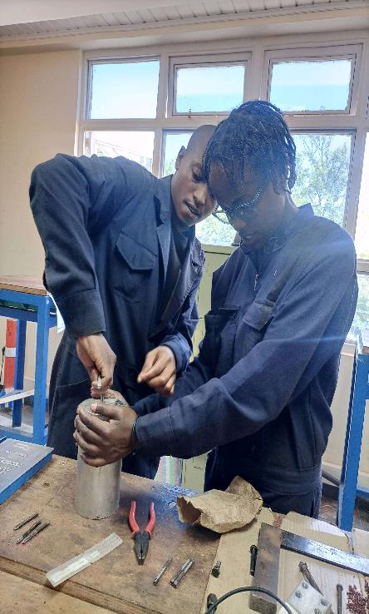
#57ALUMINIUM MOTOR HOLDER

Slide 9
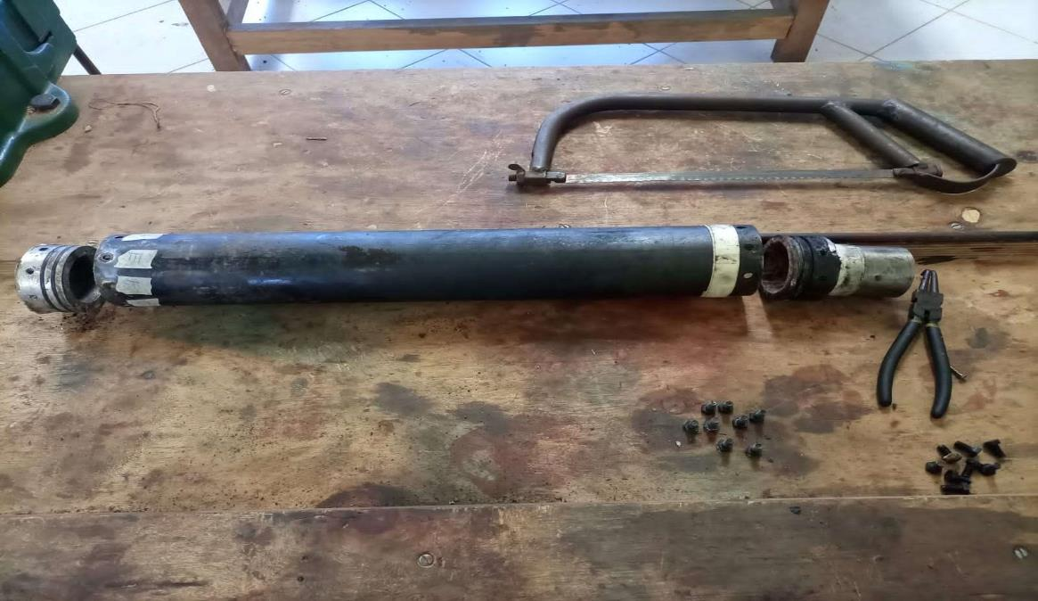
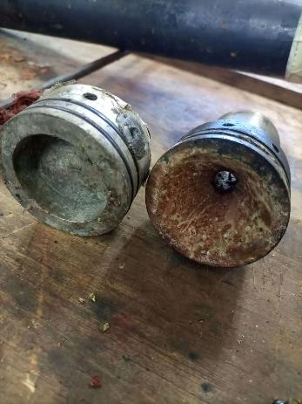
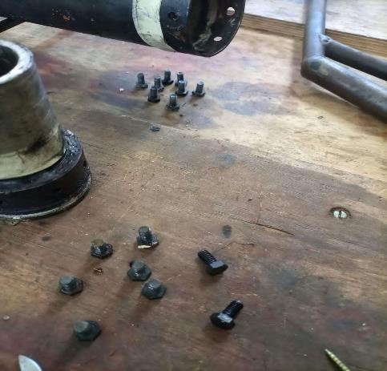
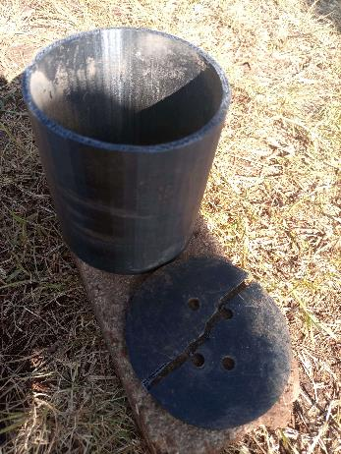
#58MOTOR DISASSEMBLY
GOOD CONDITION | DAMAGED
BULKHEAD AND ITS O-RINGS | NOZZLE O-RINGS
NOZZLE | MOTOR HOLDER
MOTOR CASING
BOLTS

Slide 10
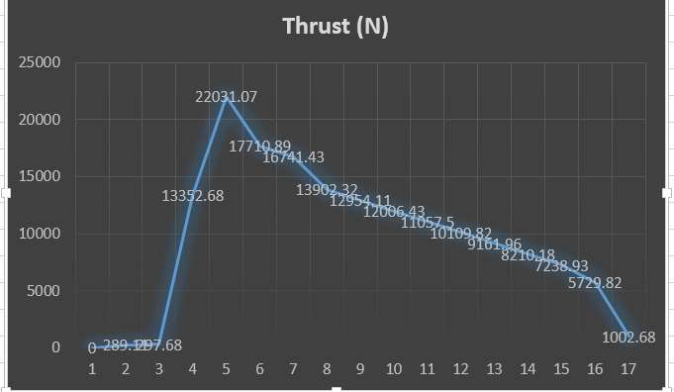
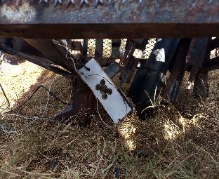
#46 STATIC TEST RESULTS ANALYSIS
A maximum thrust of 22.031kgf(216N).
Failure of the loadcell support at 216N??
WHY???

Slide 11
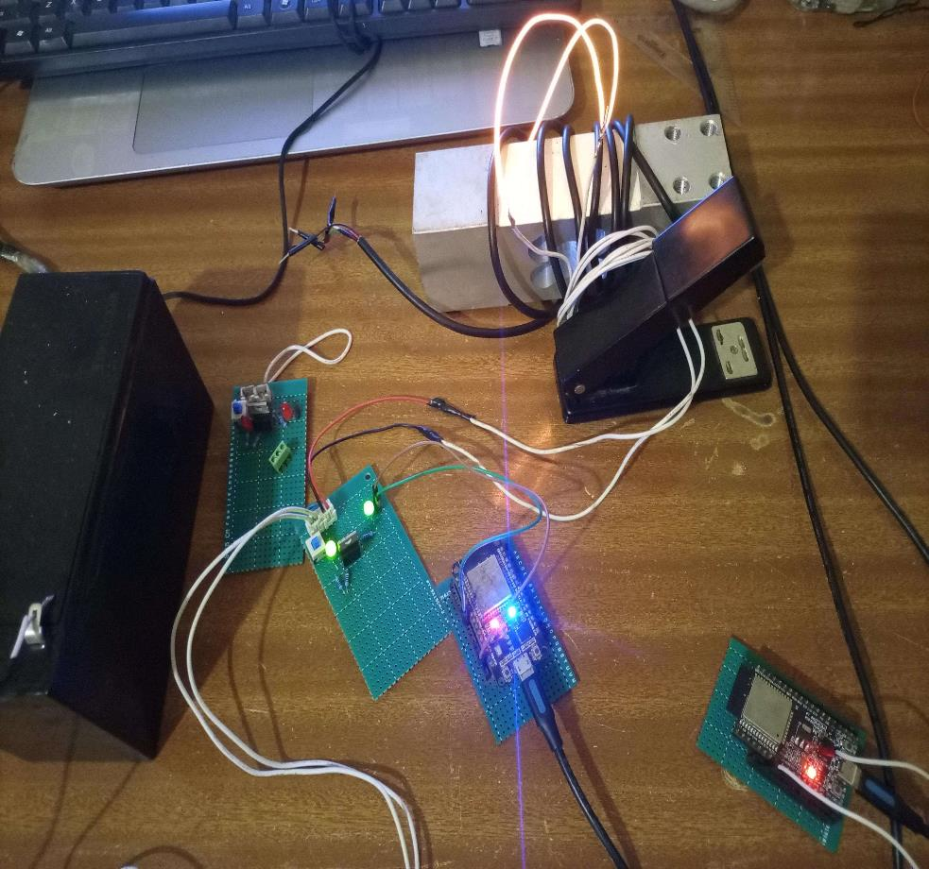
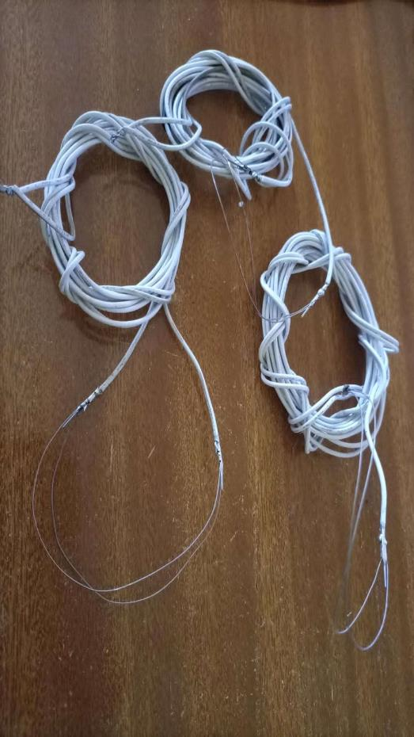
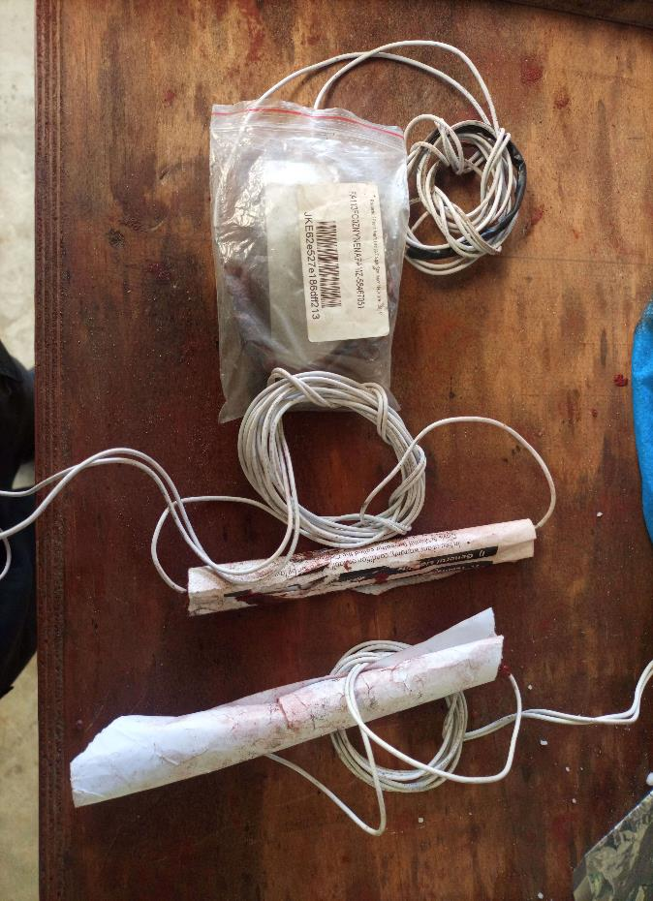
#59 IGNITION CIRCUIT AND IGNITORS

Slide 12
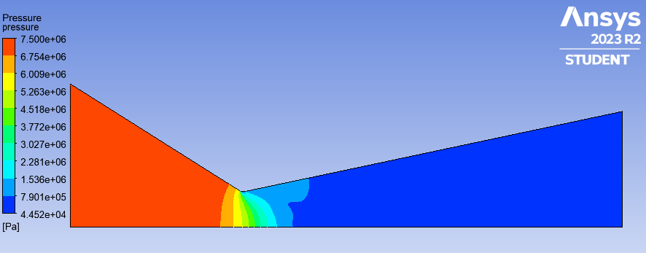
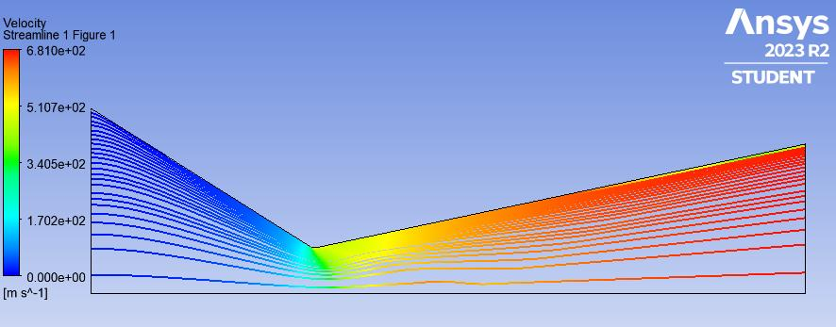
#44 NOZZLE SIMULATION
BOUNDARY CONDITIONS
Inlet-7.5Mpa gauge
Outlet-101.325KPa(atmospheric)
FINDINGS
The flow of gas at outlet increased to supersonic speed(Mach>1)
The design of the nozzle is okay

Slide 13
CHALLENGES
An extra longer power extension cable needed.
M4-M8 Drill bits required.

Slide 14
NEXT WEEK’S OBJECTIVES
Machining of:
Nozzles
Bulkheads
Design of the casting tool
Agree on bolting method to airframe
Fabrication of ignition circuit
Cooking of grains
Storage of grains method

Slide 15

THANK YOU

